Slide 1
Mobile programming
Lecture 4

Slide 2
Recall!
The area of the variable.
Variable rules.
Java - Basic Operators
Arithmetic Operators
Relational Operators
Bitwise Operators
Logical Operators
Assignment Operators
Misc Operators

Slide 3
Recall!
Unicode
ASCII − for the United States.
ISO 8859-1 − for Western European Language.
KOI-8 − for Russian.
GB18030 and BIG-5 − for Chinese.

Slide 4
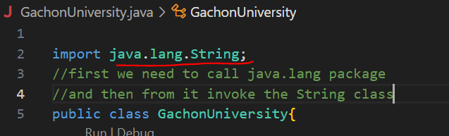
Java - Strings Class
Strings, which are widely used in Java programming, are a sequence of characters. In Java programming language, strings are treated as objects. The Java platform provides the String class to create and manipulate strings
How to use String class?
java.lang is the package which includes all classes of the language

Slide 5
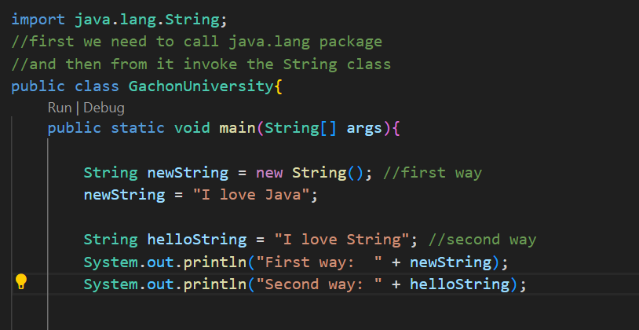
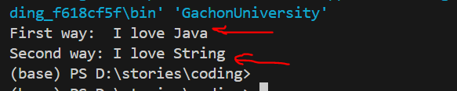
Note − The String class is immutable, so that once it is created a String object cannot be changed. If there is a necessity to make a lot of modifications to Strings of characters, then you should use String Buffer & String Builder Classes.

Slide 6
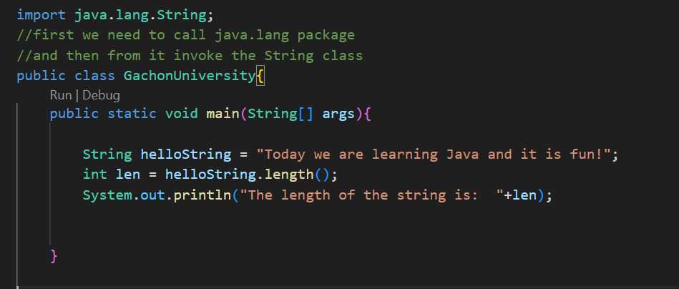

String Length
Methods used to obtain information about an object are known as accessor methods. One accessor method that you can use with strings is the length() method, which returns the number of characters contained in the string object.
The following program is an example of length(), method String class

Slide 7
Concatenating Strings
The String class includes a method for concatenating two strings −
This returns a new string that is string1 with string2 added to it at the end. You can also use the concat() method with string literals, as in
Strings are more commonly concatenated with the + operator, as in

Slide 8
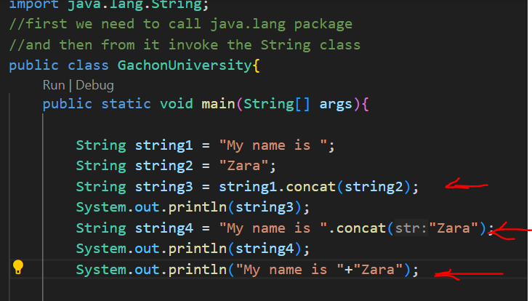
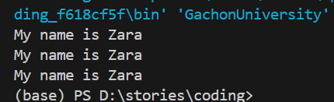
Example:
3 ways of concat

Slide 9
Exercise: Your task is to create a string, “I am, a student of the Gachon University!” find the length and concantinate it by using all 3 ways of concat with string, “and we are learning Java”.
Note
PLEASE TAKE A SCREENSHOT OF EACH ASSIGNMENT at the ending of the class i will open one assignment and you will make ppt and include each picture of assignment with name of it and number.

Slide 10
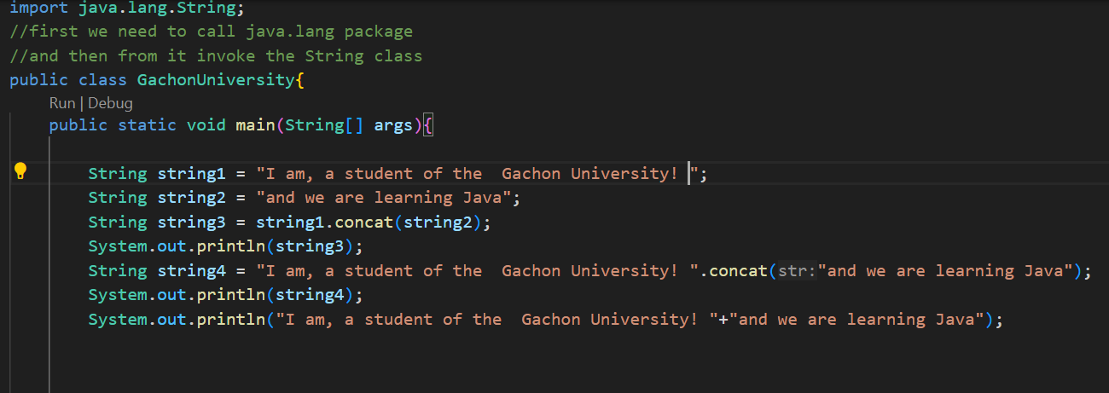
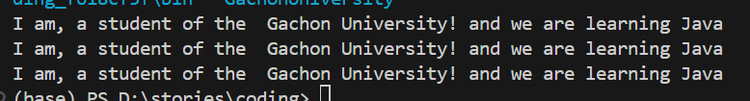

Slide 11
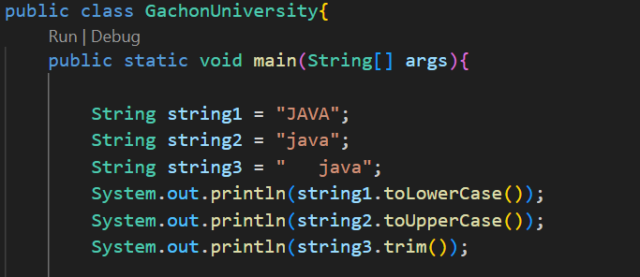
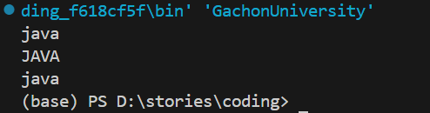
String toLowerCase()
This method converts all of the characters in this String to lower case using the rules of the default locale.
String toUpperCase()
This method converts all of the characters in this String to upper case using the rules of the default locale.
String toString()
This method returns the string itself.
String trim()This method returns a copy of the string, with leading and trailing whitespace omitted.

Slide 12
Exercise: Your task is to use all methods for given string “Gachon ” :
String toLowerCase()
String toUpperCase()
String trim()

Slide 13
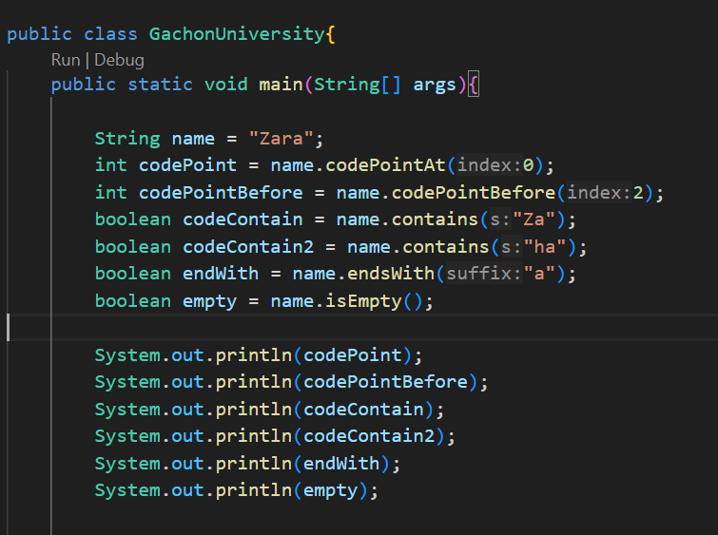
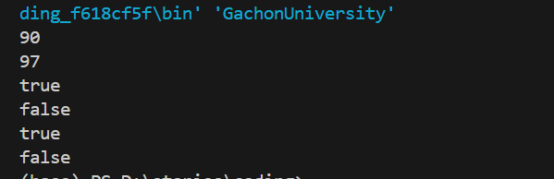
The codePointAt(index) method returns the Unicode value of the character at the specified index in a string.
The codePointBefore(index) method returns the Unicode value of the character before the specified index in a string.
The contains(“characters”) method checks whether a string contains a sequence of characters. Returns true if the characters exist and false if not.
The endsWith(“char”) method checks whether a string ends with the specified character(s).
The isEmpty() method checks whether a string is empty or not. This method returns true if the string is empty (length() is 0), and false if not.

Slide 14
Exercise: Your task is to use all methods for given string “Java is name of coffee ” : as a index you can give any number
codePointAt()
codePointBefore()
contains()
endsWith()
isEmpty()
dont forget the screenshot

Slide 15
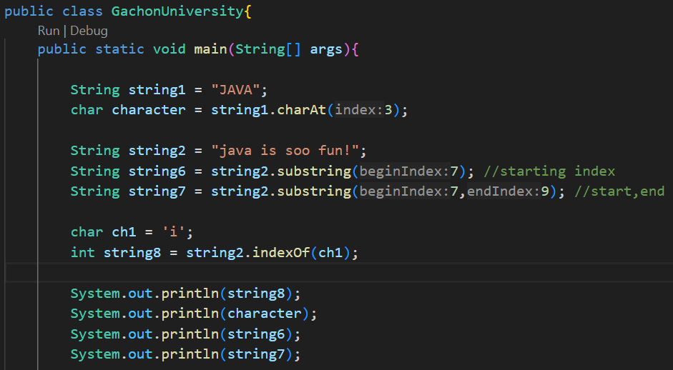
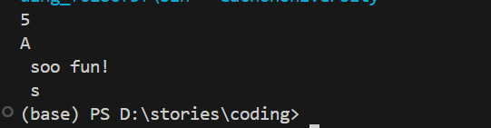
char charAt(int index)
This method returns the char value at the specified index.
.substring(index(beginning,ending) method of String class returns a substring from the given string. This method is most useful when you deal with text manipulation, parsing, or data extraction.
String indexOf(‘char’) method returns the position of the first occurrence of the specified character or string in a specified string.

Slide 16
Exercise: Your task is to use all methods for string “Education is the most powerful weapon which you can use to change the world” find idx=12, substring = [4;14] and char=’p’.
char charAt(int index)
.substring()
String indexOf()
dont forget the screenshot

Slide 17
User Input in Java
To take input from the user in Java, the Scanner class is used. The Scanner class a built-in class of java.util package. Java Scanner class provides many built-in methods to take different types of user inputs from the users.
How to Use Scanner Class to Take User Input?
Step 1: Import Scanner Class
Fist you need to import the Scanner class to use its methods. To import the Scanner class, use the following import statement
Step 2: Create Scanner Class's Object
After importing the Scanner class, you need to create its object to use its methods. To create an object of the Scanner class, invoke Scanner() constructor. Below is the statement to create an object of Scanner class −
Step 3: Take User Input
Scanner class provides a variety of methods which are useful to take user input of different types. For example, if you want to input an integer value, use nextInt() method.

Slide 18
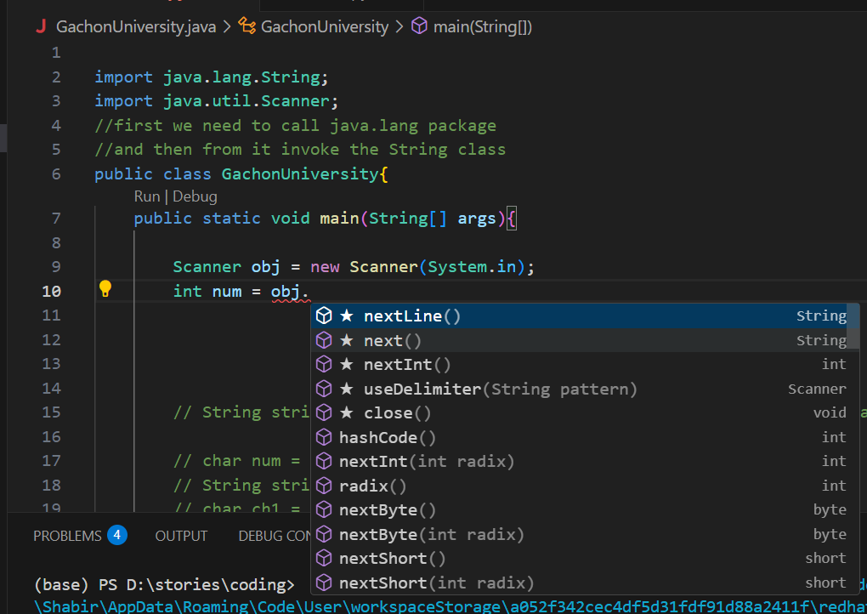

Slide 19
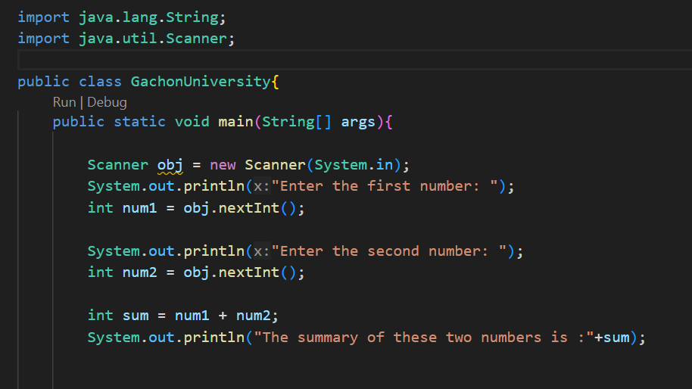
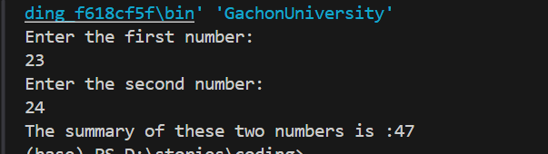
Example :
Input: The program takes two input numbers from the user and then shows the summary of them.
Output:

Slide 20
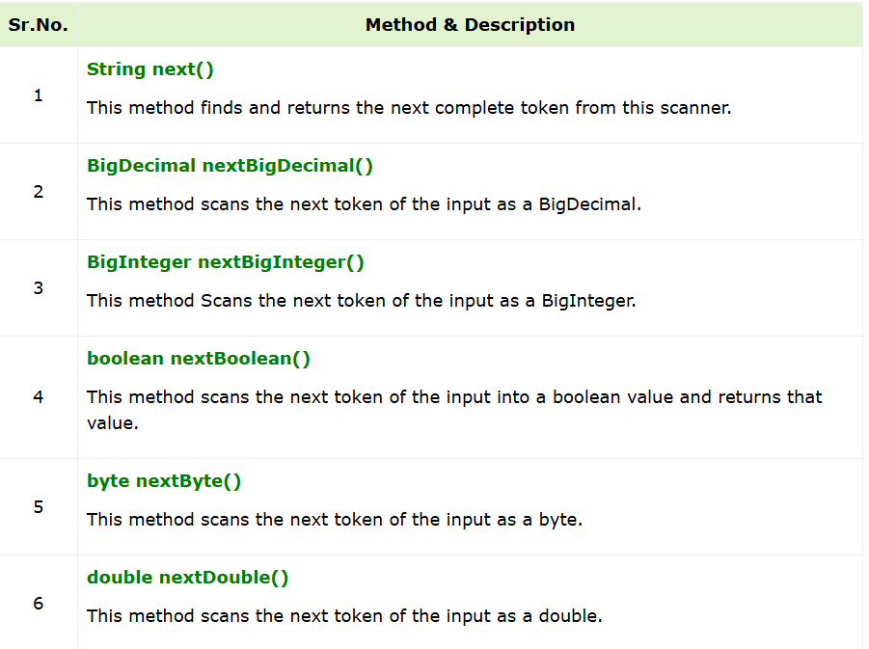
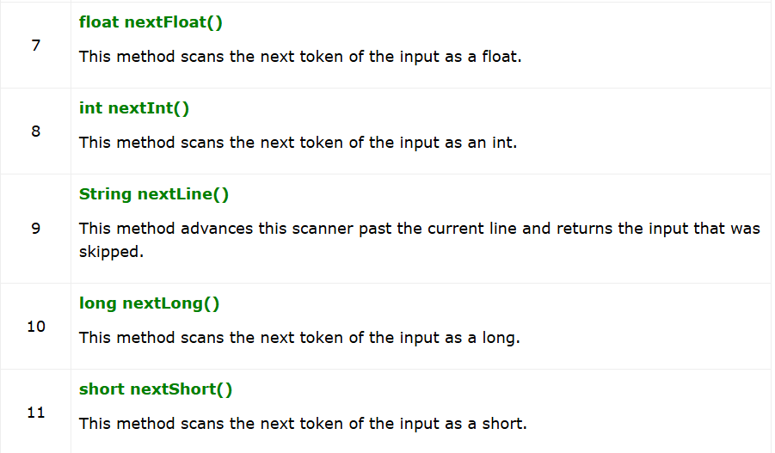
Methods for Different Types of User Inputs
The Scanner class provides different methods for the different types of User inputs. To explore all methods for different user inputs, look at the table below −
We already see the nextInt()

Slide 21
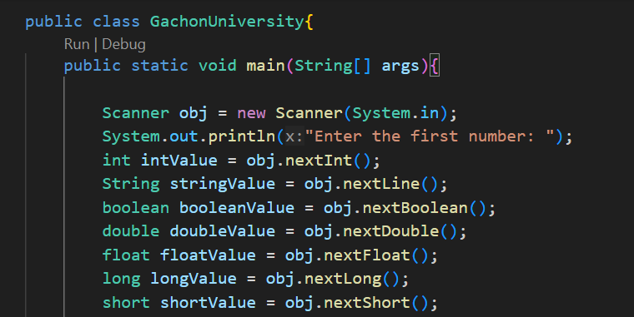
obj.next()

Slide 22
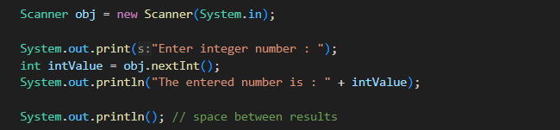



Task: Your task is to make a programm which intakes all data types and print them with name of the data type :
dont forget the screenshot
Input:
int = 24
short = 1
double = 2.3
float = 3.56
string = ‘java’
long = 12344444567890
print() output:
println() output

Slide 23
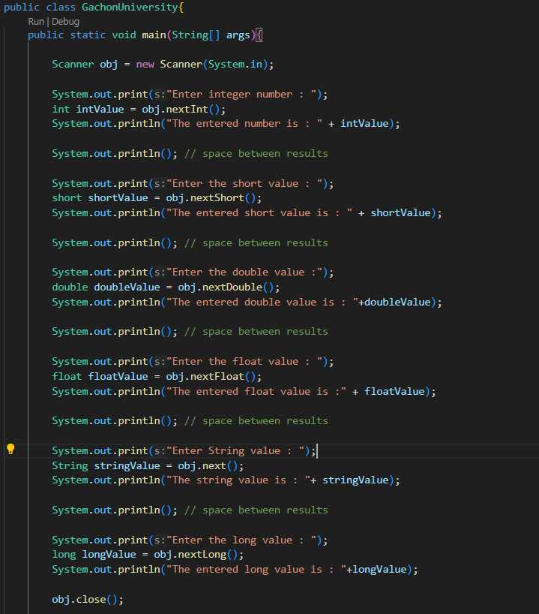
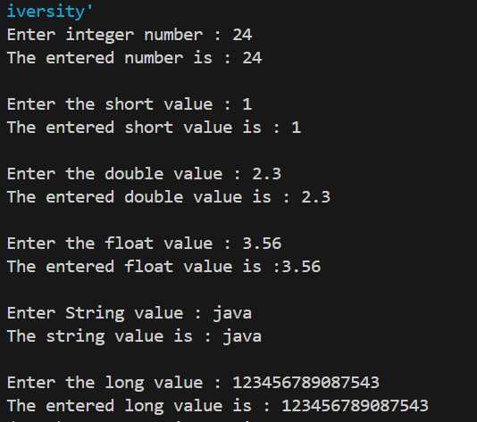

Slide 24
Task:
You are given the program that receives ;
a string - person’s name,
integer - work experience.
You need to output a short summary of the entered data in the format:
"Hi, my name is [your given name]. I’ve been working as a programmer for [your given work experience] years."

Slide 25
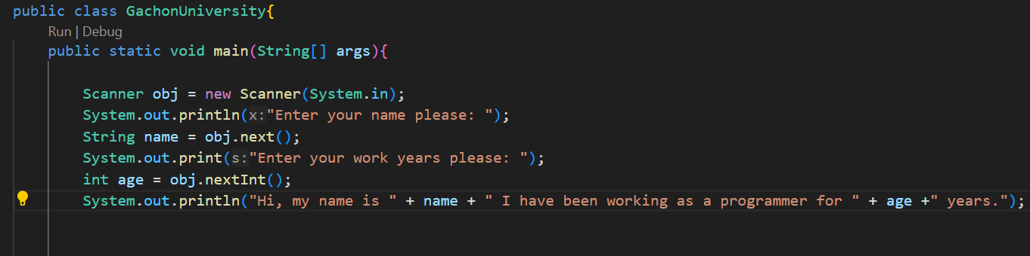
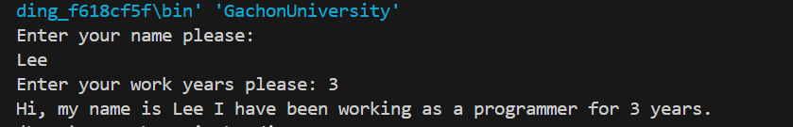

Slide 26
Task: The entry is a string. You need to extract this string in uppercase.
Sample input:
Java is fun!
Output:
JAVA IS FUN!
hint : use here nextLine() not next()

Slide 27
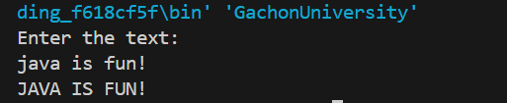
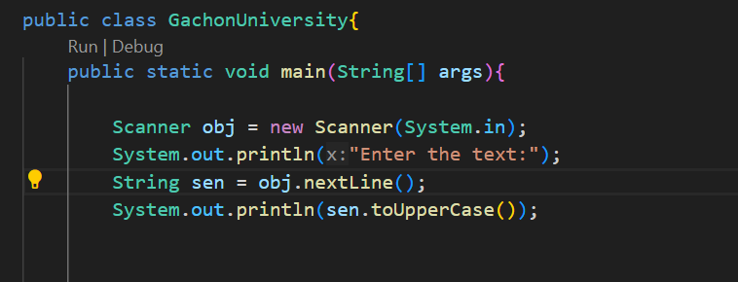

with nextLine()
with next()

Slide 28
Thanks for your attention

